Slide 1
Detecting Cartels in Public Auctions

Slide 2
What is: An association of suppliers with the purpose of maintaining prices at a high level and restricting competition.
Types of Cartels:
Price-fixing
Bid Rigging
Regional
Market-share quota
etc
Types of Agreement:
Explicit
Tacit
Notes:
bid-rigging. (public behavioral data available)

Slide 3
Why it’s so important to detect cartels
Sec. 1 of the Sherman Act: “every contract, combination in the form of trust or otherwise, or conspiracy, in restraint of trade or commerce among the several States or with foreign nations, is declared to be illegal”
price increases
Low product innovation
restrict competition
In the of public procurement, collusion leads to higher public costs and lower quality services

Slide 4
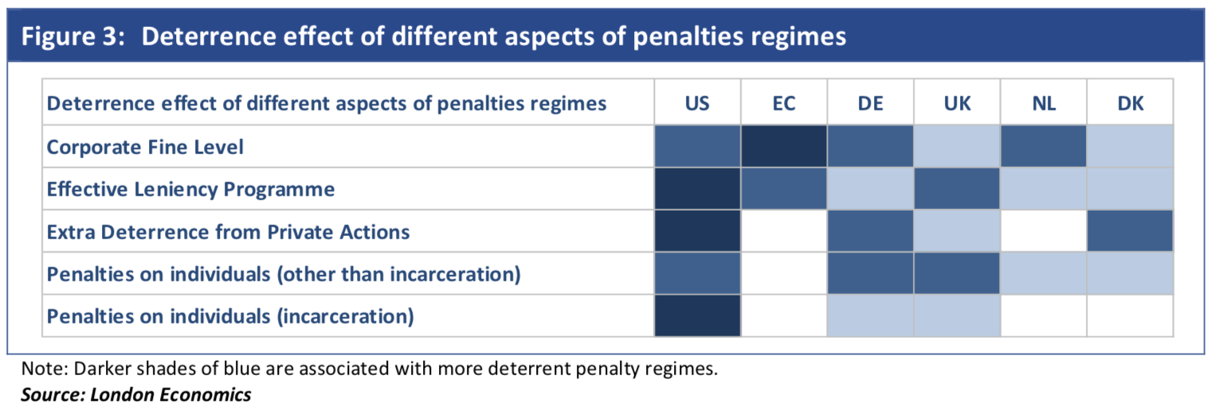
Types of Assessment
Direct evidence (prosecution)
Economic evidence (can be ambiguous; used together with direct evidence)
If an investigation into the companies’ conduct is undertaken, the participants do not cooperate with it, except through a leniency programme
Notes:
felony punishable by fines, imprisonment or both.

Slide 5
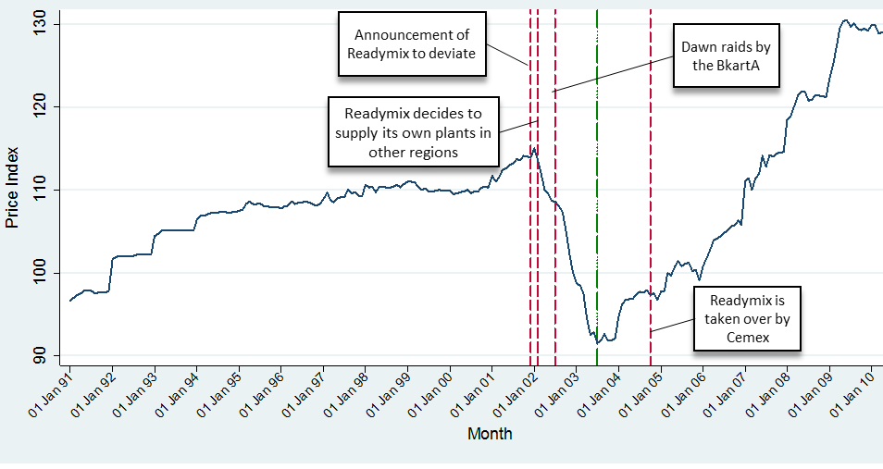
Example of Economic Assessment (price-fixing cartel)
Cartel
Price-war
Article: “Cartel damage estimation – calculating the price overcharge”. Banfi, Carla; Bernardo, Natália. (2015)

Slide 6
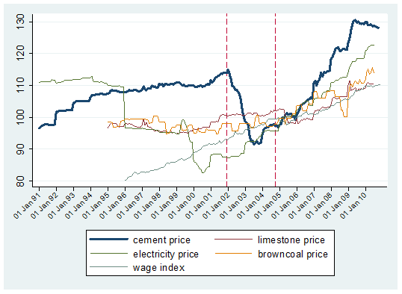
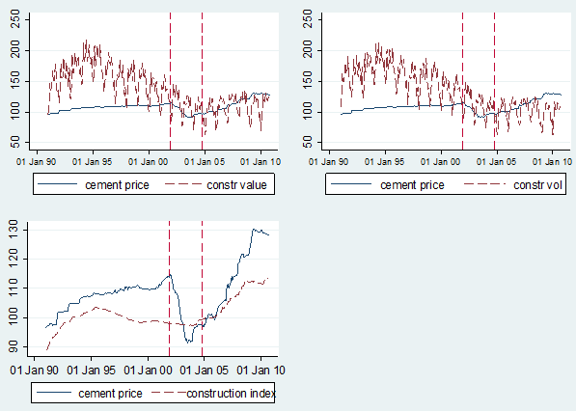
Example of Economic Assessment
Cement vs. inputs price
Cement price vs. demand factors
Damage assessment:
${Price }_{t}$ = $β_{0 }+β_{cartel }Cartel+β_{war }war+β_{input }input+β_{demand }demand$
Overcharge = ${Price }_{cartel }−$ ${Price }_{no−cartel }$
Notes:
inputs with larger correlation with the price of cement

Slide 7
Common Collusion Schemes in Public Bidding 1. Bid-rotation

Slide 8
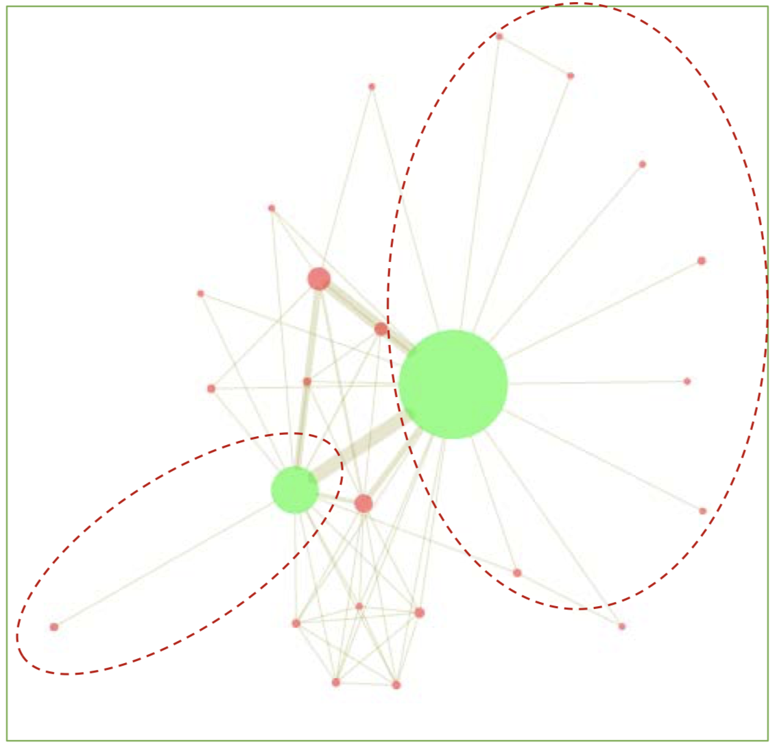
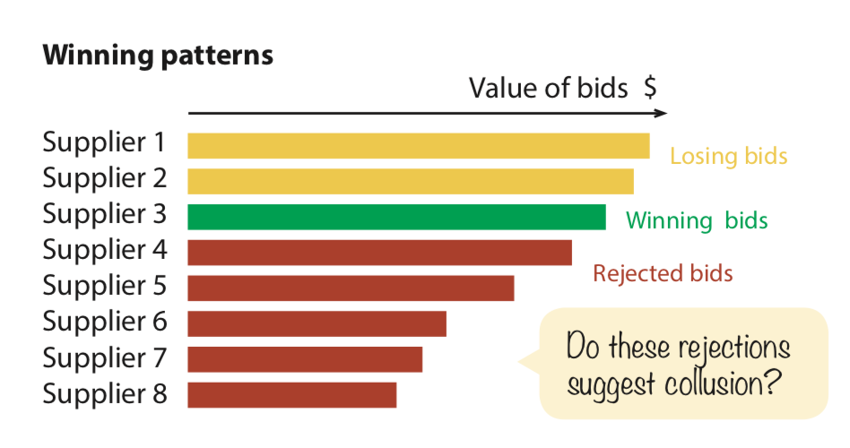
Common Collusion Schemes in Public Bidding 2. Split reward
Co-bidding network in Swedish public procurement market (2009-2014)
Winner suppliers
Notes:
One of the most straightforward ways to mimic competition while in fact coordinating bidding and pre-determining who wins is when competitors recurrently submit losing bids making a pre-selected company a sure winner. This indicator captures such a situation. observing a dominant company winning always or almost always while a set of ‘competitors’ bidding, but losing always or almost always may signal collusion.
When colluding firms control the entire market and the company extracting rents (i.e. winning)is the same over a longer period, it is possible to identify distinct network formations underlying this kind of collusion.
Under this scheme, cooperating bidders agree to submit higher priced or deliberately defective bids to ensure the selection of the designated winner at inflated prices. In exchange, the winner might pay a percentage of its profits to the losing bidders, hire them as subcontractors, or allow them to win other high priced contracts.
a case where sup-pliers four to eight always bid a little less that the winning bid suggesting another type of collusion.

Slide 9
Common Collusion Schemes in Public Bidding 3. Market Division
Cable companies in the US
Notes:
Many cable companies in the United States of America have split themselves off into regions to stop competition. This is considered Market Division Scheme and can create regional monopolies.
Bids are in dollars. Since the bids are reported in their entirety, and since bids on all but the smallest markets are at least six digits, bidders can use the last few digits of a bid to encode messages. For example, in the AB auction (Auction 4), GTE frequently ended its bids with “483,” which spells GTE on the telephone keypad. In the same auction, American Portable, a subsidiary of TDS, signaled interest in some markets by spelling “TDS” (837) in the last three digits. In the nationwide narrowband auction(Auction 1), one bidder ended its bid with the phone number of Congressman John Dingell, who introduced the legislation to auction spectrum.

Slide 10
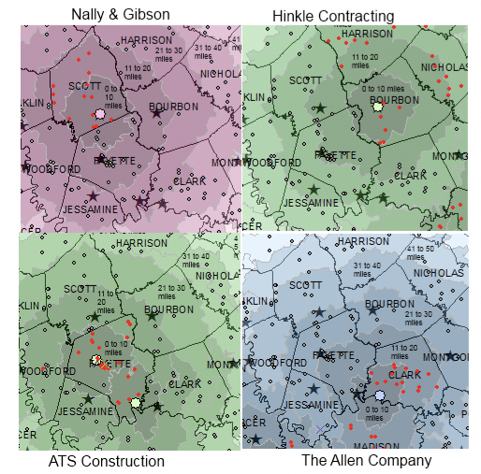
Case study 1: Collusion in Highway Procurement Auctions
Data: asphalt paving auctions conducted in Kentucky in 2005-2007
80% of bid in Kentucky made by only one contractor
Firms refraining from bidding across county lines
Single-bidder auctions with prices approaching monopoly levels.
Impact: bids were $70.6 million higher than they would have been without collusion.
Article: “Single Bidders and Tacit Collusionin Highway Procurement Auctions”. Barrus, D; Scott, F. (2013)
Notes:
The proportion of single-bid contracts in asphalt resurfacing auctions has approached 80 percent.
In this paper we collect data on all asphalt paving auctions conducted by the Kentucky Transportation Cabinet during the years 2005-2007
regions with two or three potential competitors but where firms refrain from bidding across county lines, resulting in single-bidder auctions with prices approaching monopoly levels.
Financial Impact of Single-Bid Contracts
Tacit collusion in the form of refraining from bidding in KY during the 2005-2007 period resulted in bids that were $70.6 million higher than they would have been if such behavior had not occurred.

Slide 11
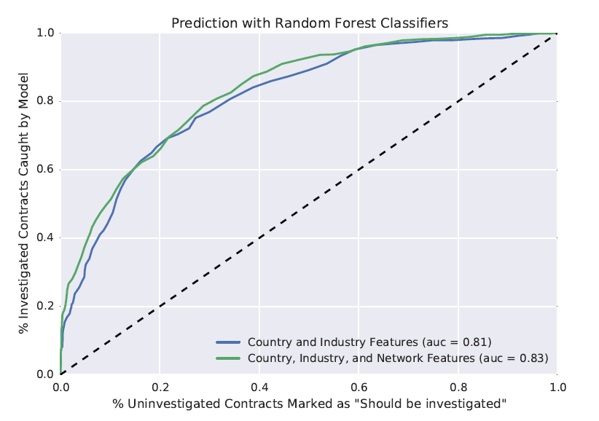
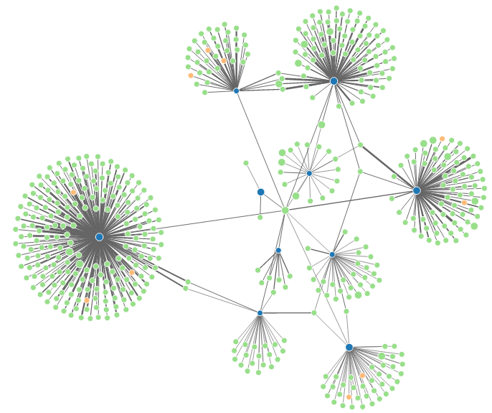
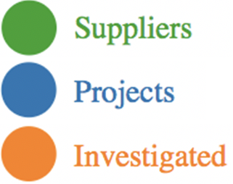
Case study 2: world bank Predict the level of risk for a contract
Investigations data:
Projects
outcomes
Economic development indicators
Contract data:
+300,000 contracts funded by World Bank loans (20 years)
Data
2. Classification: risk/ no risk
1. Co-award networks
Products
Notes:
Contractors providing goods and services on WorldBank projects are typically hired through acompetitive bidding process. Occasionally,prospective contractors influence the competitivesystem by colluding with other contractors, bribinggovernment officials, or otherwise manipulating thebidding process.
A company that works with companies or on projects that have been investigated by the World Bank are more likely to be investigated themselves
Companies that are on many projects together mayknow each other better and have the opportunity tocollude

Slide 12
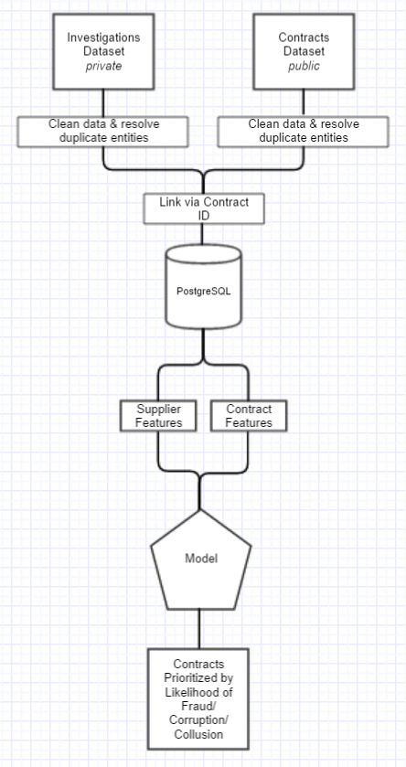
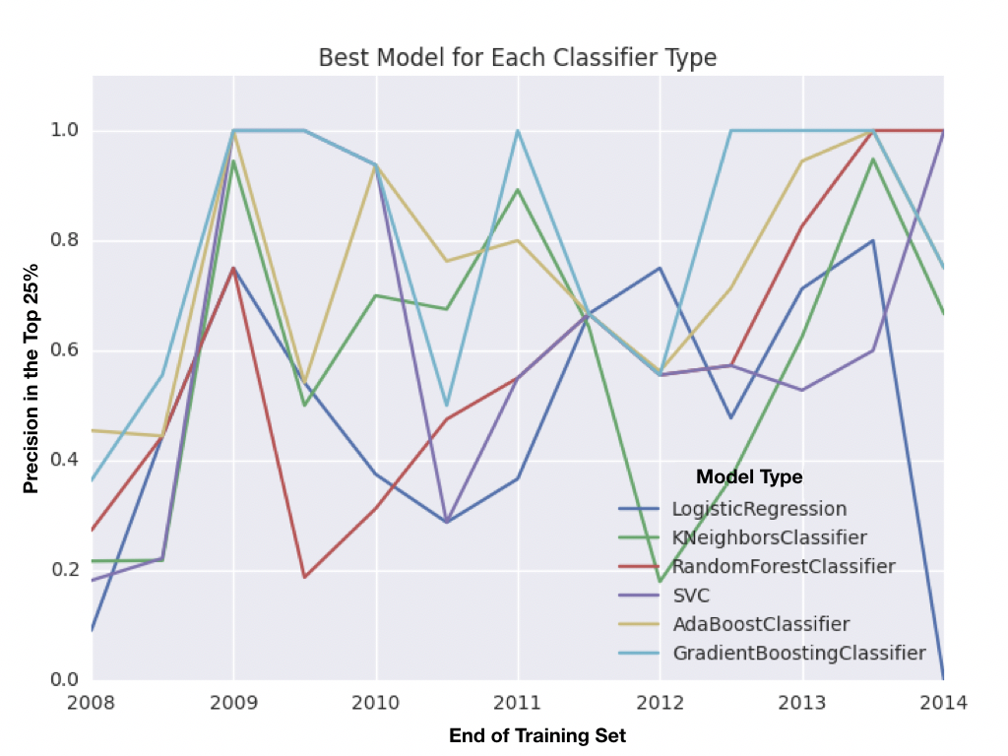
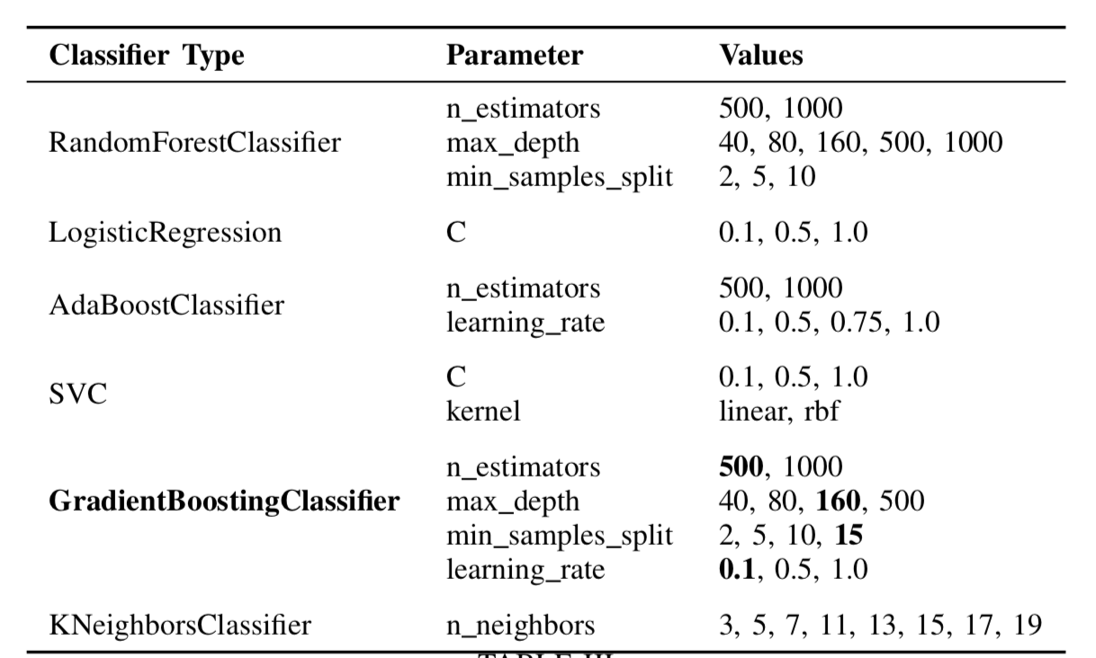
Study case 1: world bank
The model was trained on past investigations data, where the outcome of the investigation was used asthe training label.
1) Country of previous contracts
2) Region of previous contracts
3) Major Sector of previous contracts (e.g. agriculture,
transportation, etc.)
4) Procurement Type of previous contracts (e.g. infrastruc-
ture, medical equipment, maintenance, etc.)
5) Procurement Category of previous contracts (e.g. goods,
consultant services, or civil works)
Final Model:Based on precision at those levels, the bestperforming model across all train and test sets was the Gradi-ent Boosting Classifier.
Notes:
To discover fraud, corruption, and collusion, the WorldBank currently uses a complaint-based investigation process.

Slide 13
Study case 1: world bank
The model was trained on past investigations data, where the outcome of the investigation was used as the training label.
1) Country of previous contracts
2) Region of previous contracts
3) Major Sector of previous contracts (e.g. agriculture,
transportation, etc.)
4) Procurement Type of previous contracts (e.g. infrastruc-
ture, medical equipment, maintenance, etc.)
5) Procurement Category of previous contracts (e.g. goods,
consultant services, or civil works)
Notes:
To discover fraud, corruption, and collusion, the WorldBank currently uses a complaint-based investigation process.
Final Model:Based on precision at those levels, the bestperforming model across all train and test sets was the Gradi-ent Boosting Classifier.
The model was trained on past investigations data, where the outcome of the investigation was used as the training label.

Slide 14
Study case 2: world bank Predict the level of risk for a contract
Data
Contract Data:
+300,000 contracts funded by World Bank loans from the past 20 years
Investigation Data:
Results of investigations for collusion in the past years
Classification models
Training-set:
Past contracts
Labels: contract was investigated/not investigated
Model
A random forest provided the best results across all metrics
Outcome:
0 – should be investigated
1 – should not be investigated
Notes:
The World Bank Group lends billions of dollars each year to fund development projects in its efforts to reduce global poverty. My team and I, are helping investigators at the Bank search for patterns of collusion, corruption, and fraud in its contracts data, using models of contract-specific risk.
over 300,000 major contracts funded by World Bank loans from the past 20 years,
In terms of the model, we trained a binary classifier separating past contracts that were investigated by the World Bank from those that were not investigated. We evaluated and compared models using precision, recall, and area under ROC curve. A random forest provided the best results across all metrics on a held-out test set.

